Slide 1

Stock Research Application
Group 5
CS4471

Slide 2
Demo Division
Architecture Overview - Connor
Earnings Call Service - Shikhar
Market News Sentiment Service - Shikhar
Stock Analysis Service – Harjap
Portfolio Management Service - Zac
Service Registry - Abdullah

Slide 3

Problem Statement
Fragmented stock research tools
Hard to combine pricing, indicators, and news
Need for a unified, modular research platform

Slide 4

Project Overview
Our Stock Research Application provides an integrated platform for users to:
analyze stocks
manage their portfolio
explore market research
through a modern, modular software architecture.

Slide 5

User Personas
Casual Investor: wants simple charts and insights
Research Analyst: wants deep indicators + historical data
Student / Learner: needs clarity and reliability

Slide 6
Key Features
Stock symbol search
Live or near-real-time price lookups
Historical charts
Technical indicators (MA, RSI, MACD, etc.)
News + sentiment information
Portfolio Management

Slide 7
High Level Architecture
Microservices:
Stock Analysis Service
Market News Service
Portfolio Service
Earnings Service
Service Registry

Slide 8
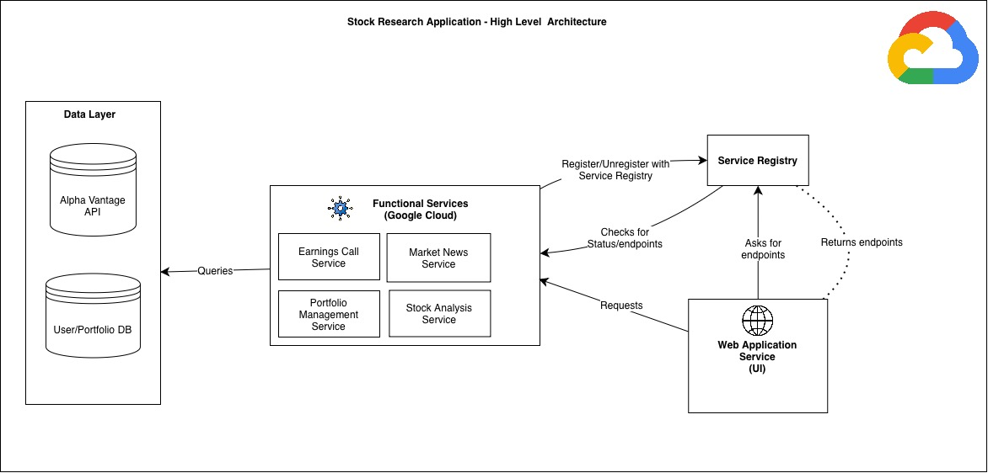
High Level Architecture Diagram

Slide 9
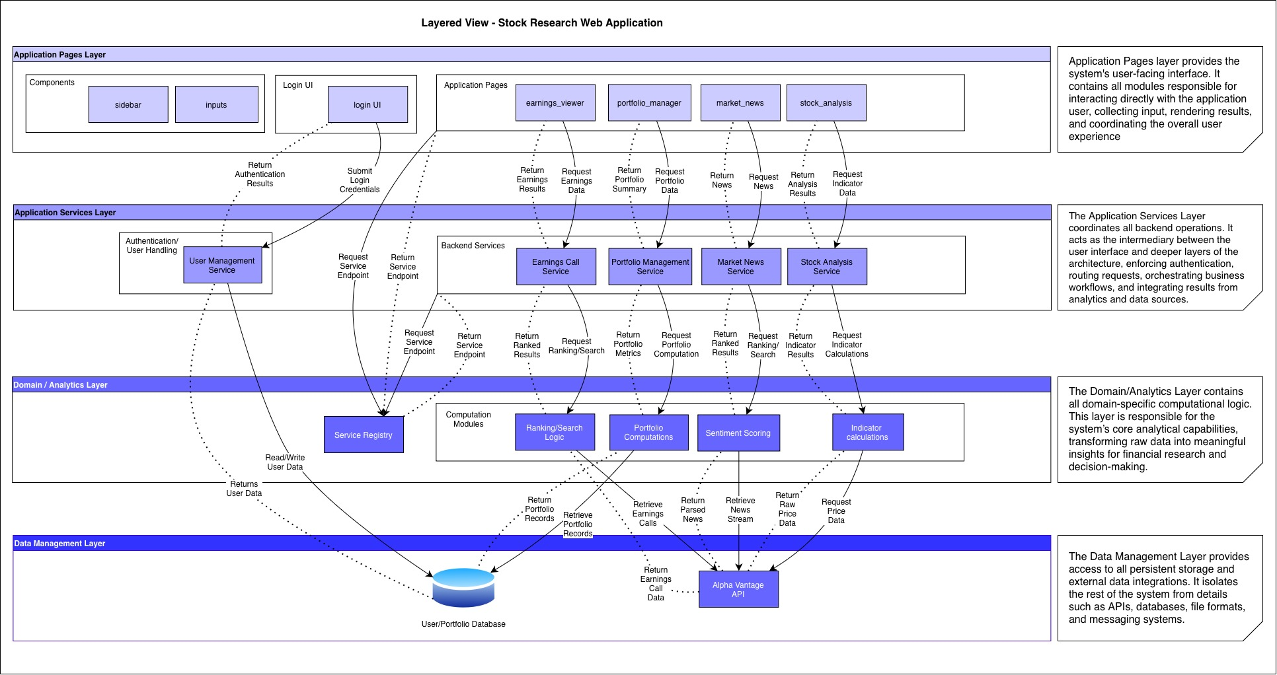

Slide 10

API Workflow
User searches a symbol
Web App queries Service Registry
Calls appropriate microservice
Service fetches data or returns cached results
Web App aggregates + renders to UI

Slide 11
Testing
Unit Tests – auth, data, utils, services
Subsystem Tests - pages
BlackBox Tests - app

Slide 12
Demo

